Slide 1


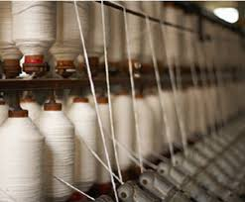
COLLEGE OF MANAGEMENT SCIENCES
Analysis Of Pakistan
Project :Analysis Of Textile Spinning Of Pakistan
FALL2017
The textile industry is often considered the backbone of the Islamic Republic of Pakistan’s economy.
In Asia, Pakistan is the 8th largest exporter of textile products providing employment to 38percent of the work force in the country.
The textile industry contributes approximately 46percent to the total output or 8.5 percent of the country GDP.
Top Key Players Of Textile Spinning
Indus Dyeing And Manufacturing Company Limited.
Gadoon Textile Mills Limited.
Fazal Cloths Limited
Portal Five Force Model
Entry & Exit Barrier
Bargaining Power of Supplier
Bargaining Power of Buyer
Level of Competition
Substitute Product
PESTLE ANALYSIS
Political / Economical
Social / Technology
Legal / Environmental
SWOT ANALYSIS
STRENGTH:
Raw material
Availability of cheep labor
Domestic Market
OPPORTUNITY:
Pakistan textile city
Marketing
Relationship with foreigner
WEAKNESS:
Research In development
Poor Infrastructure
THREATS:
New competitors
Fashion life cycle
SUBMITTED TO:
Syeda Quratulain Kazmi
SUBMITTED BY :
SHAHRYAR SIDDIQUI
RAZA RAWJWANI
HABIB NASEER
SAAD REHMAN

